Slide 1
HR Attrition Analytics Dashboard
Using Tableau to uncover insights and guide data-driven HR strategies

Slide 2
Understanding the Problem
Employee attrition remains a major challenge for organizations.
High turnover rates increase recruitment costs, disrupt productivity, and lower team morale.
Key questions we aimed to answer:
Why are employees leaving?
Which departments or demographics are most affected?
What can HR do to improve retention?

Slide 3
Project Overview
Title: About the HR Analytics Dashboard
Tool Used: Tableau
Objective: To analyze and visualize employee attrition trends.
Dataset Includes: Age, Gender, Department, Job Role, Income, Work-Life Balance, Overtime, and Satisfaction Levels.
Goal: Turn raw HR data into clear insights that support data-driven retention strategies.

Slide 4
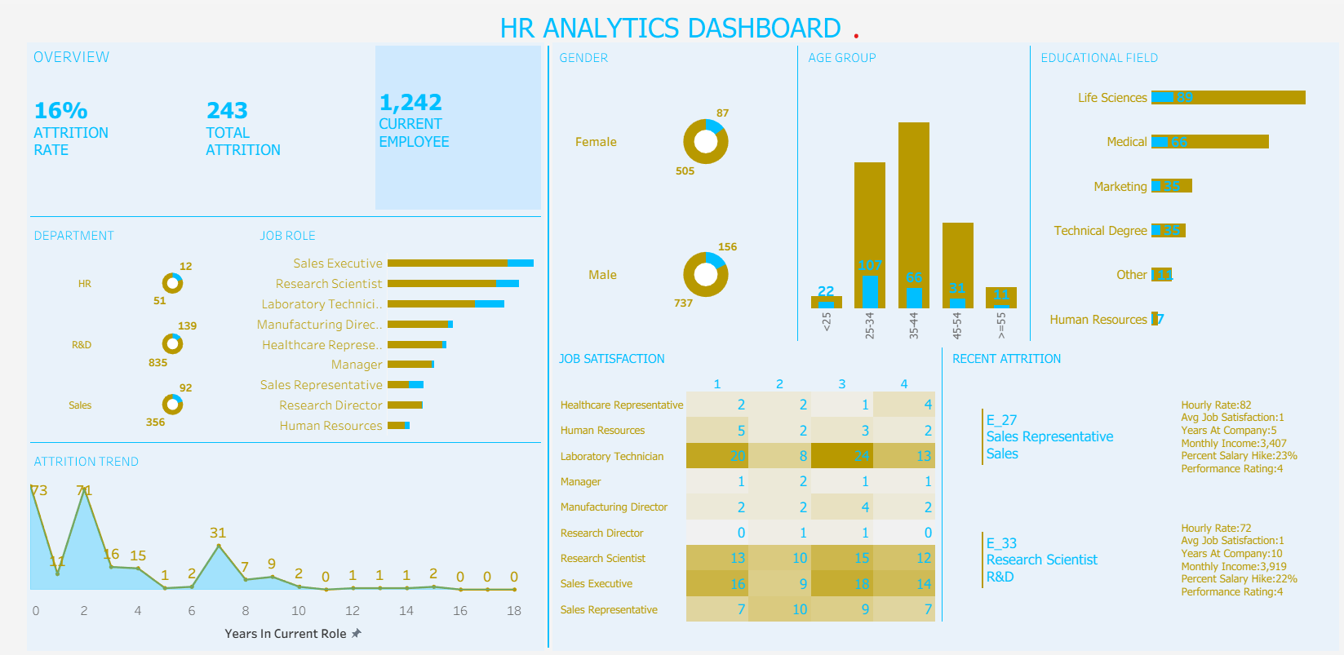
Interactive Tableau Dashboard Overview

Slide 5
Insights from the Dashboard
Job Satisfaction & Work-Life Balance:
Employees with lower satisfaction or poor work-life balance are more likely to leave.
Overtime:
Overtime correlates strongly with high attrition, particularly among younger staff.
Income Disparity:
Departments with lower income averages experience higher turnover.
Career Growth:
Mid-level employees (3–7 years) show the highest attrition due to limited progression.
Department-Level Trends:
Certain departments have consistently higher attrition, signaling management or workload concerns.

Slide 6
Actionable Insights
✅ Improve Work-Life Balance: Introduce flexible schedules or hybrid work options. ✅ Review Compensation Structures: Align pay with performance and market benchmarks. ✅ Enhance Career Development: Offer clear promotion pathways and training opportunities. ✅ Address Overtime Issues: Reassess workload distribution and overtime policies. ✅ Conduct Regular Employee Surveys: Measure satisfaction and engagement levels quarterly.

Slide 7
Turning Insights into Action
The HR Attrition Dashboard transforms data into strategy. By leveraging analytics, organizations can:
Identify hidden attrition drivers.
Build proactive retention plans.
Foster a stable, motivated, and loyal workforce.
Final Note: Data is powerful when it drives decisions. This dashboard empowers HR leaders to act before attrition happens.

